Slide 1


Parents' Information Session for New Starters Welcome!
We’re so pleased to welcome you and your child to our school.
This session will help you feel confident and informed as your child begins Reception with us.

Slide 2

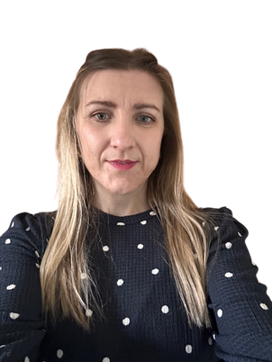
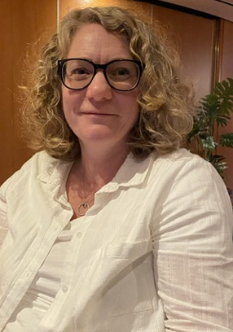
Meet the Staff
Mr Layhe-Humphreys- Headteacher
Mrs Flori Bors- EYFS and KS1 Teacher
Miss Vicki Parkin- KS2 teacher and SENCO

Slide 3



Mrs Sam Tannahill- Teaching Assistant
Mrs Alison Evelill- Teaching Assistant
Mr Matt Ray- Teaching Assistant & Mental Health Lead & After school club

Slide 4

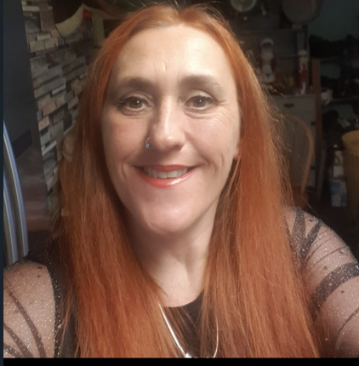
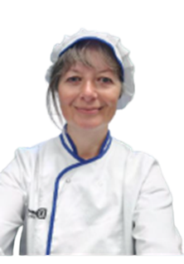
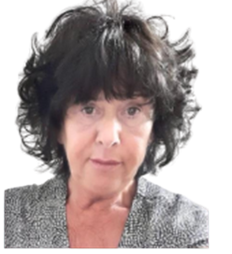
Mrs Jenny Williams- Business Manager
Mrs Ellen Shirtcliffe- Mid-day supervisor
& Caretaker
Mrs Sharon Willment- Breakfast Club
Mrs Claire Morris- Cook

Slide 5
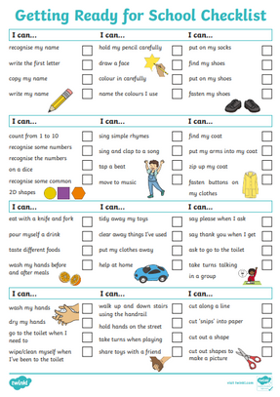

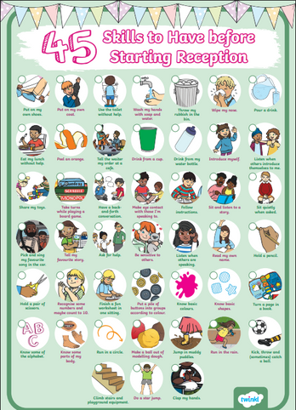
What Does It Mean to Be School Ready?
Able to dress and toilet independently
Can follow simple instructions
-Recognises their name
Able to share and take turns

Slide 6
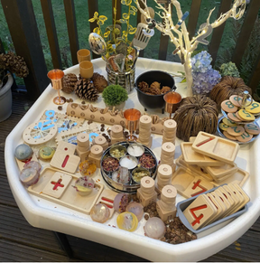
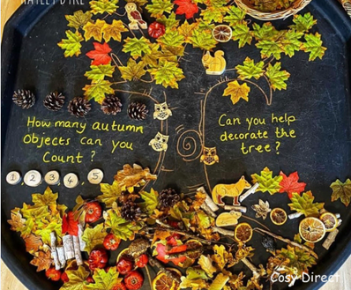
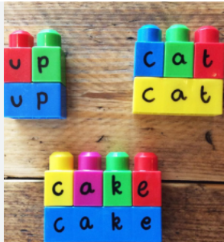
A Typical Day in Reception
-dough disco
-squiggle wiggle
-movement breaks
Children take part in Phonics, English, Maths play-based learning, snack time, outdoor learning and story time.

Slide 7
  Phonics/English
  How We Teach Phonics in the Infants Class
  We use Monster Phonics to deliver our daily phonics lessons in a fun, engaging, and effective way. This award-winning programme uses a multisensory approach—linking sounds, colours, characters, and actions—to help children learn their letters and sounds more quickly and confidently. Children also use Monster Phonics decodable books to practise reading and develop strong decoding skills. This structured approach supports faster progress in reading and spelling, setting the foundation for future learning.
  Maths
  In our infant classroom, we make maths practical, engaging, and meaningful. We follow the White Rose Maths scheme, which helps children build strong number sense through small, carefully sequenced steps. To support understanding, we use a range of hands-on resources such as Numicon, cubes, and rekenreks, which allow children to see and explore mathematical concepts in a concrete way. This approach helps children develop confidence, fluency, and a deep understanding of number from the very beginning of their learning journey.
Morning routine
Each morning, children take part in focused, small-group sessions designed to support their learning and development. These include handwriting, phonics, English, and maths, allowing us to tailor teaching to their individual needs and provide targeted support in key areas.

Slide 8
  Afternoon Routine – COOL Time in EYFS
  In the afternoons, our Reception children take part in what we call COOL Time – Choosing Our Own Learning. This is a vital part of the EYFS day where children explore carefully planned continuous provision that reinforces the concepts taught in the morning.
  COOL Time encourages children to develop independence, strengthen their critical thinking, and practise essential social skills through purposeful play and child-led exploration. This time allows children to revisit and deepen their understanding in a rich, engaging environment, supporting their all-round development in a way that’s both fun and meaningful.
Afternoon routine

Slide 9

Reading
  Reading Expectations
  Reading is at the heart of everything we do, and we believe that daily reading at home plays a vital role in your child’s development.
  Every day, your child will bring home a reading record and a book to share with you. In the early stages, this may be a picture book with no words. These books are an excellent way to support your child’s language and communication skills. We encourage you to look at the pictures together, talk about what you see, and describe the story using your own words. This helps develop vocabulary, comprehension, and storytelling skills. Please record this into the reading record every time you bread.
  As your child begins to learn their phonics and letter sounds, through Monster Phonics, they will start to bring home books that contain words and sentences. At this stage, please support your child by reading with them, encouraging them to sound out words, blend sounds, and read simple sentences independently where possible.
  We kindly ask that you record each reading session in your child’s reading record, ideally every day. Even a short session makes a big difference when it is done consistently.
  Thank you for your continued support in helping us foster a lifelong love of reading in your child.

Slide 10
Lunch time/snack time
  🍽️ Lunch:
  - Freshly cooked on-site every day by Miss Morris
  - Children choose their meal each morning (includes vegetarian option)
  - Link to menu will be provided
  🥛 Free Milk:
  - Free for children under 5
  - Available after age 5 for a small charge (opt-in)
  🍎 Morning Snack:
  - Fresh fruit provided daily during morning break
  🍌 Afternoon Snack:
  - Children may bring a healthy snack (no crisps or chocolate)
  - Fruit is always available if they don’t bring one
  💧 Water Bottles:
  - Bring a water-filled bottle daily (labelled with name)
  - Water only, unless medically exempt
  - Bottles go home each day and return the next morning

Slide 11

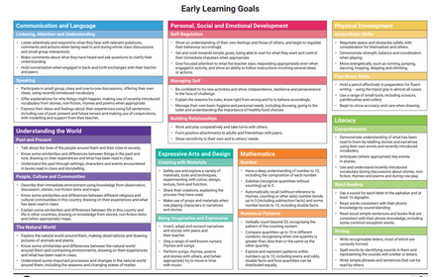
The EYFS framework supports development in:
Curriculum Overview – EYFS Framework
- Prime Areas: Communication, Physical Development, Personal & Social
- Specific Areas: Literacy, Maths, Understanding the World, Expressive Arts
Play is central to all learning.

Slide 12


Communication with Parents
Regular updates via Parent Hub or school website
Monthly newsletters
Parents` meetings twice a year
End of year report
Morning meet and greet
Family Fun Friday

Slide 13

Settling In – What to Expect
- Staggered starts for new children- first 2 weeks
- Tips to support separation
- Staff are experienced and nurturing to help ease the transition

Slide 14
In Willow Class, we follow the school’s behaviour policy and promote a calm, respectful, and nurturing learning environment. Children are encouraged to follow our school rules, which are consistently reinforced and modelled by all staff throughout the day.
We believe in celebrating and rewarding positive behaviour. Children earn house points and pom-poms for showing kindness, making good choices, helping others, and trying their best. These rewards help motivate and encourage a strong sense of responsibility and teamwork.
When behaviour needs to be addressed, we use gentle and consistent strategies. Children may lose pom-poms as a visual and immediate reminder of their choices. In some cases, they may be asked to miss part of their playtime to reflect and discuss how they can make better choices next time.
Our approach is rooted in positive reinforcement, fairness, and helping children learn to manage their emotions and behaviour independently. We work closely with parents to support each child’s development and ensure they feel safe, supported, and successful at school.
Behaviour and rewards
-

Slide 15

PTFA
Join Our PTFA – Your Support Makes a Difference!
The Parents, Teachers, and Friends Association (PTFA) would love to welcome you to the team! This dedicated group meets regularly at school to plan and organize a variety of fun and meaningful fundraising events that directly benefit our students and school community.
Whether you can offer time, ideas, resources, or simply an extra pair of hands at an event, your involvement—big or small—makes a real impact. No prior experience is needed, just a willingness to contribute and be part of a supportive, friendly team.
Joining the PTFA is also a great way to meet other parents and staff, stay involved in school life, and help create exciting opportunities for our children.
We’d love to have you on board—every little bit of help is truly appreciated!
For more information or to express your interest, please contact or speak to a member of staff or school office.

Slide 16
Church News
Church News
As a proud church school, we are deeply committed to maintaining strong and meaningful links with our local church. Our pupils regularly take part in collective worship at the church, helping to strengthen our shared values and community spirit.
Throughout the year, we also hold many special events at the church, including the school nativity, Mothering Sunday celebrations, Christingle services, and more. These moments are an important part of our school calendar and provide wonderful opportunities for reflection, celebration, and togetherness.
In addition, the church warmly invites all parents and carers to its weekly drop-in sessions every Wednesday, where you can enjoy tea, toast, and friendly conversation in a relaxed and welcoming space. Whether you're a regular visitor or dropping in for the first time, you’ll always be made to feel at home.
Everyone is welcome—come along and be part of our school and church family.

Slide 17

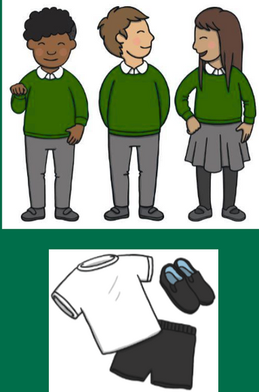




Uniform and What to Bring
Our uniform consists of:
    Black or grey trousers, skirt or dress
    White polo shirt
    Green gingham dress
    Emerald green jumper or cardigan, preferably with the school logo
    Black shoes
- School uniform (see website)
- PE kit on Wednesdays and Fridays
-Wellies (to stay in school)
PE Kit:
    Navy or black shorts
    White t-shirt
    Pumps or soft trainers for indoors
    We have PE on a Wednesday and Friday- children come in PE kit
- Water bottle and book bag
- Spare clothes in a labelled bag

Slide 18
Attendance and Punctuality
- School starts promptly at 9 (open doors at 8.45-main front entrance)
-schools ends at 3.30-collect from the playground (gates open at @3.25)
Breakfast club 7.30 to 8.45.
After School Clubs (3.30pm - 5.30pm daily)
- Consistent attendance builds routine and confidence
- Call the school office to report absences

Slide 19






Questions and Contact Information
Thank you for joining us!
Please feel free to ask any questions.
Contact us: phone or email
Phone: 01629 582862
Email: info@matlockbath.Derbyshire.sch.uk
Website: https://www.mbhtprimaryschool.org.uk

